Slide 1


GIT & GITHUB

Slide 2
What is Git?
Git is a popular version control system. It was created by Linus Torvalds in 2005, and has been maintained by Junio Hamano since then.
It is used for:
Tracking code changes
Tracking who made changes
Coding collaboration

Slide 3
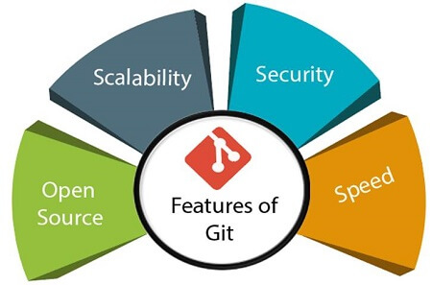
Features of Git

Slide 4
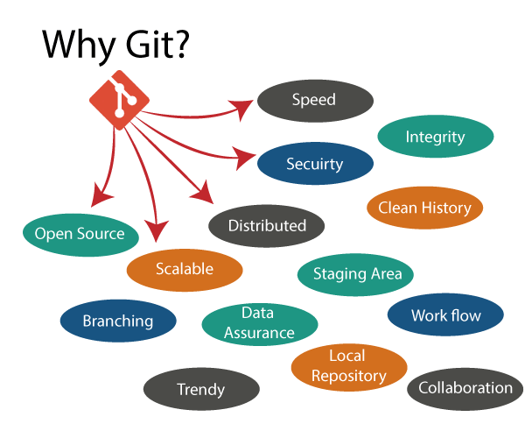
Benefits of Git

Slide 5
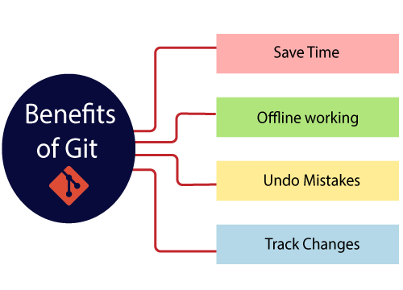
Benefits of Git

Slide 6
What does Git do?
Manage projects with Repositories
Clone a project to work on a local copy
Control and track changes with Staging and Committing
Branch and Merge to allow for work on different parts and versions of a project
Pull the latest version of the project to a local copy
Push local updates to the main project

Slide 7
Working with Git
Initialize Git on a folder, making it a Repository
Git now creates a hidden folder to keep track of changes in that folder
When a file is changed, added or deleted, it is considered modified
You select the modified files you want to Stage
The Staged files are Committed, which prompts Git to store a permanent snapshot of the files
Git allows you to see the full history of every commit.
You can revert back to any previous commit.
Git does not store a separate copy of every file in every commit, but keeps track of changes made in each commit!

Slide 8
What is GitHub?
1.GitHub is a Collaboration platform. It is built on top of git.
2.It allows you to keep both local and remote copies of your project.
3. A project which you can publish it among your team members as they can use it and update it from there itself.

Slide 9
Advantages of Using Git Hub For Selenium.
When multiple people work on the same project they can update project details and inform other team members simultaneously.
Jenkins can help us to regularly build the project from the remote repository this helps us to keep track of failed builds

Slide 10
Git Binaries Installation
Step 1) Launch the Browser and navigate to URL- https://git-scm.com/
Step 2) Download the latest stable release.
Step 3) Click on downloads for windows once the file is downloaded we can begin with our installation.

Slide 11
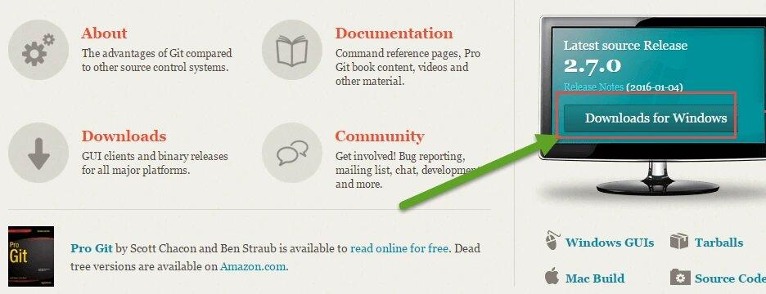

Slide 12
Step 4) Go to the download location or icon and run the installer.
Step 5) Click through welcome and General Public license.
Step 6) Click on “next” button in git setup wizard

Slide 13
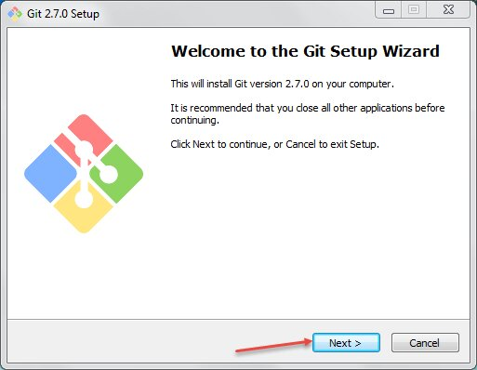

Slide 14
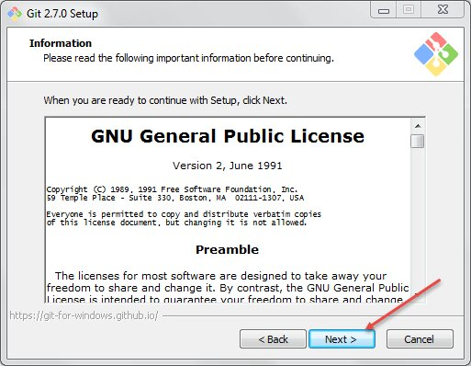
Step 7) Read the GNU General Public License and click on next

Slide 15
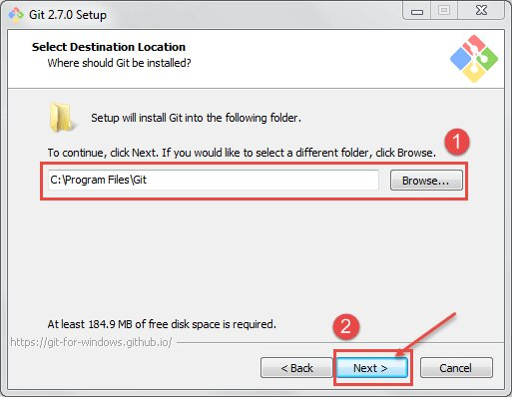
Step 8) In this step,
Select the Directory where you want to install “Git Binaries” and
Click on next button

Slide 16
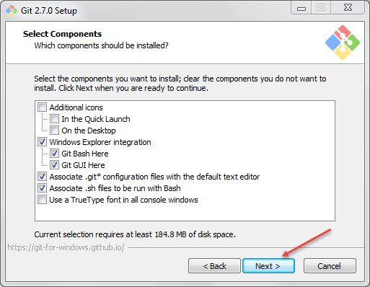
Step 9) Select the component which you want to install and click on next

Slide 17
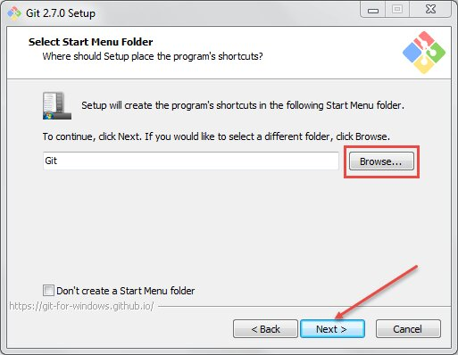
Step 10) If you want to create a start menu folder for Git, leave the setting default and click on

Slide 18
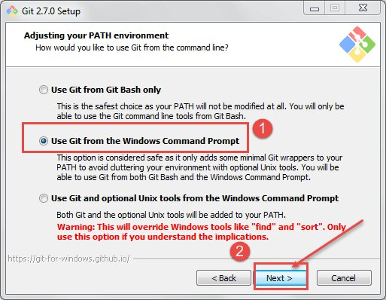
Step 11) In this step,
Select Use Git from the Windows Command Prompt to run Git from the command line and
Click on next.

Slide 19
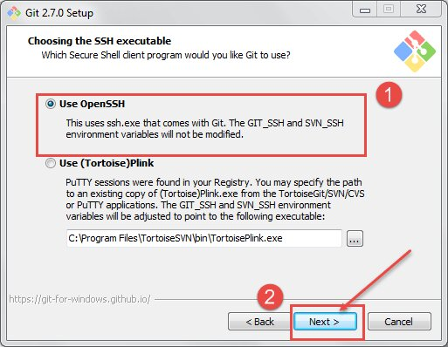
Step 12) In this step,
Select Use Open SSH It will help us to execute the command from the command line, and it will set the environmental path.
Click on next button.

Slide 20
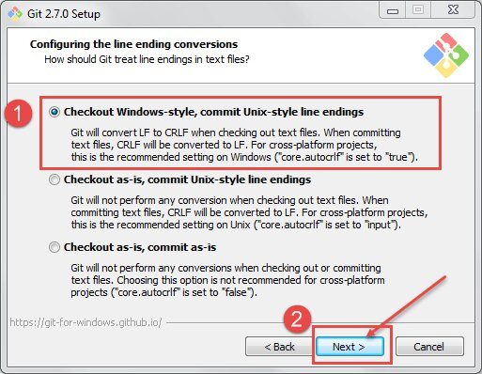
Step 13) In this step,
Select “Checkout windows-style, commit Unix-style line ending”.(how the git hub should treat line endings in text files).
Click on next button.

Slide 21
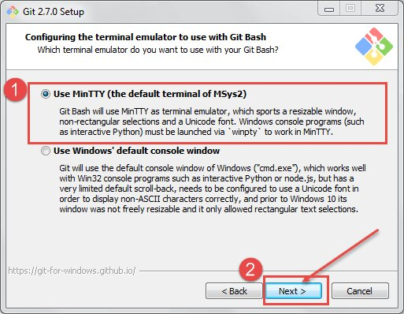
Step 14) In this step,
Select Use MinTTY is the default terminal of MSys2 for Git Bash
Click on next button

Slide 22
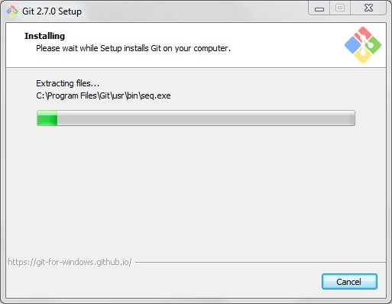
Once git is installed successfully, you can access the git.
Open Command prompt and type “git” and hit “Enter” If you see below screen means it is installed successfully

Slide 23
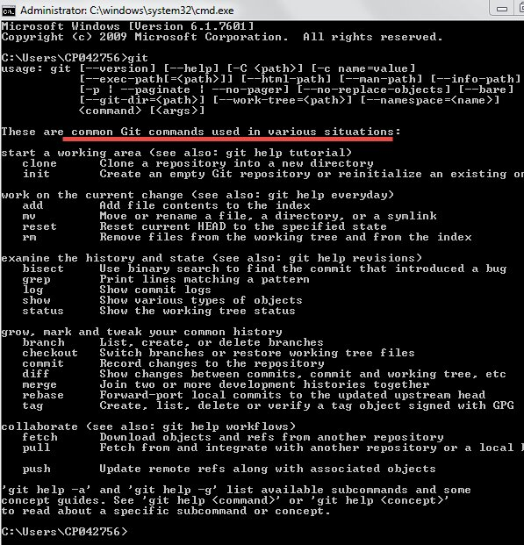

Slide 24
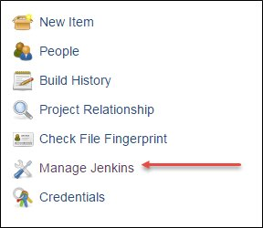
Jenkins Git Plugin Install
Now let’s start with Jenkins Git Plugin Installation.
Step 1) Launch the Browser and navigate to your Jenkins.
Step 2) Click on Manage Jenkins.

Slide 25

Step 3) Click on Manage Plugins, it will open another window
Step 4) Click on Available TAB

Slide 26
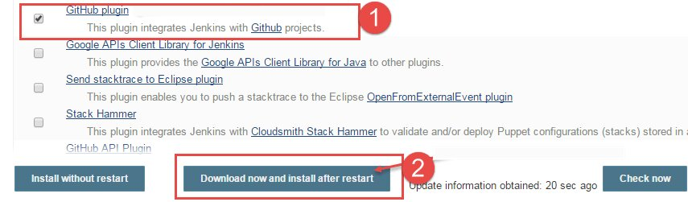
Step 5) In this step,
Select GitHub plugin then
Click on Download now and install after restart button.

Slide 27
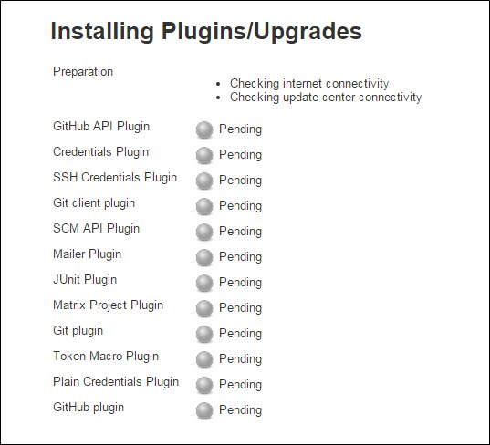
Now it will install the following plugins.
Once the Installation is finished. Restart your Tomcat server by calling the “shutdown.bat” file

Slide 28
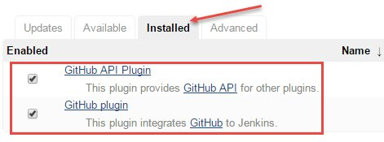
After Restarting the tomcat and Jenkins we can see plugins are installed in the “Installed” TAB.

Slide 29
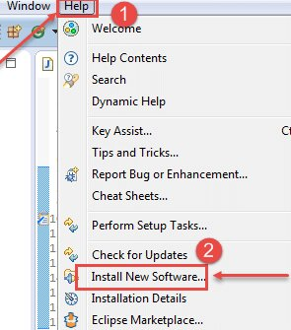
Setting Up our Eclipse with GitHub Plugin
1. install GitHub Plugin for Eclipse.
2.URI for EGit Plugin location https://download.eclipse.org/egit/updates/
Step 1) Launch Eclipse and then
Click on help button then
Click on install new software

Slide 30
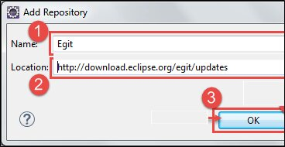
Step 2) The below screen will open once we click on the install new software. Now click on add
Step 3) In this step,
Type the name “EGIT” and
Enter the location https://download.eclipse.org/egit/updates/ then
Click on ok.

Slide 31
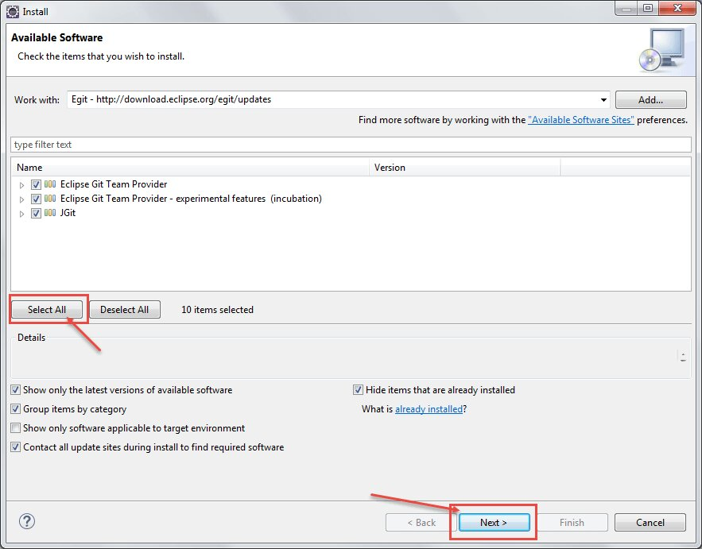
Step 4) Then click on select all and next

Slide 32
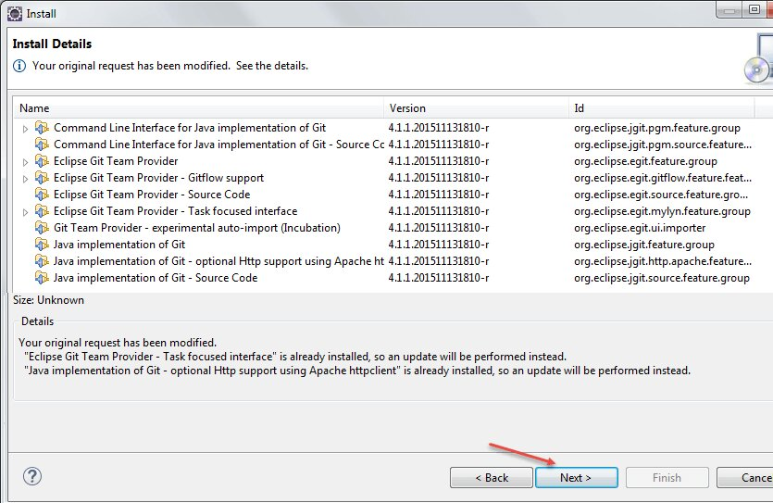
Step 5) Click on next and click accept the license agreement then finish the installation.
Then restart the eclipse.

Slide 33
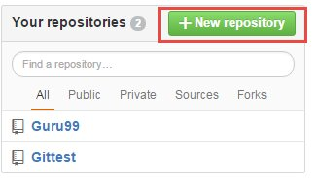
Building a repository on Git
Step 1) Navigate to Git Hub URI: https://github.com/ sign up for git hub
Step 2) Once you have been successfully signed up then click on create new repository

Slide 34
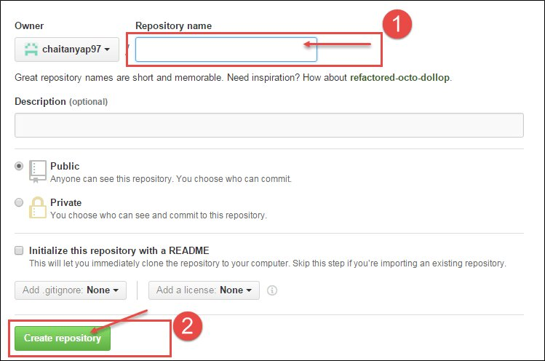
Step 3) In this step,
Enter the name of the repository and
click on create repository

